Slide 1
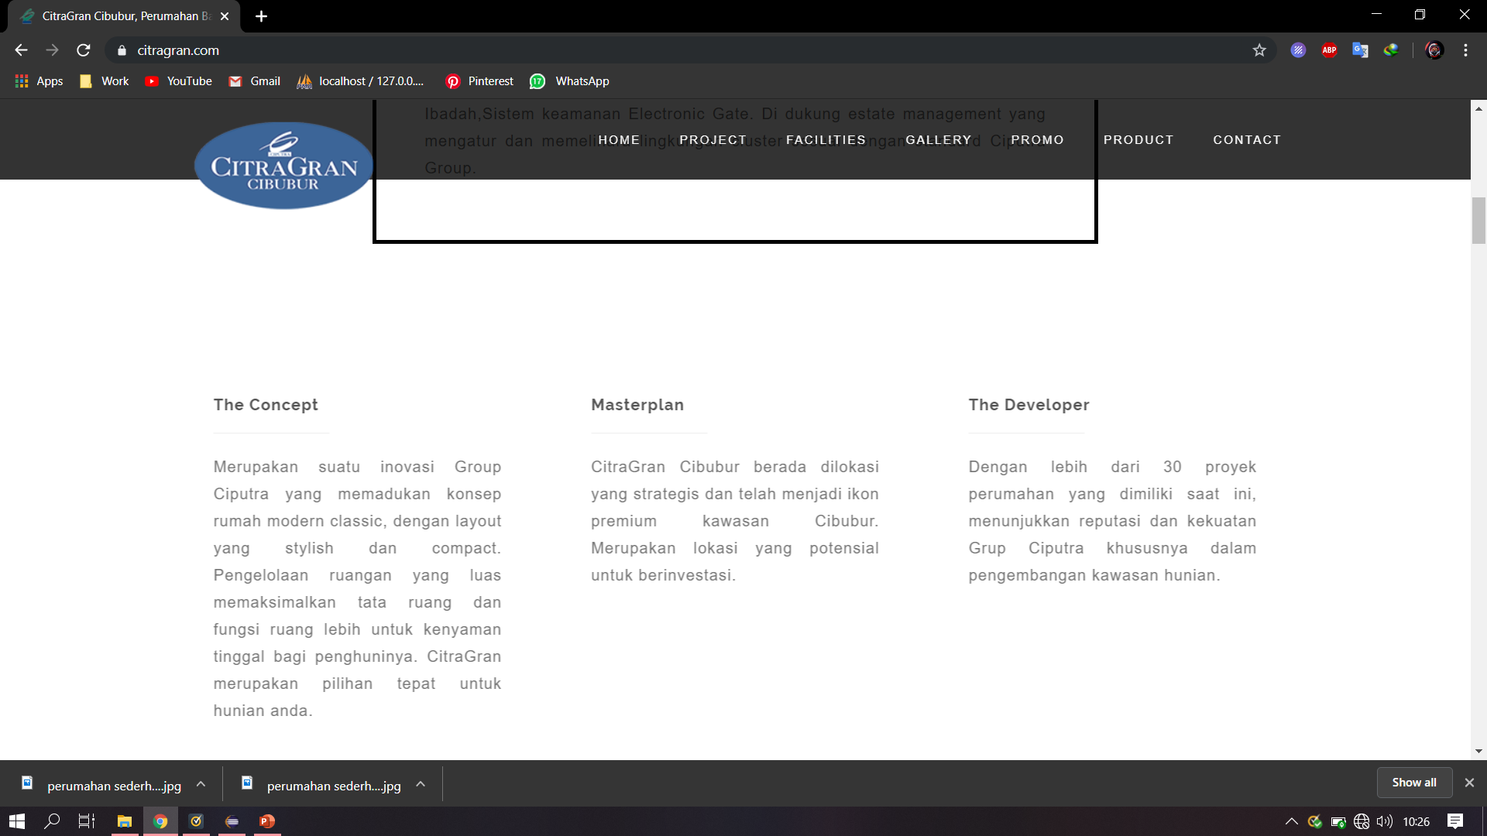
Perumahan
Home
About
Contact Us

